Slide 1


Refugee Resettlement
by Allison Hansen, Amanda Maruca, Colin Warner
Notes:
Hi everyone and welcome to our final presentation for CS5010. Amanda, Colin, and I will be presenting our findings on Refugee Resettlement from around the world between the years 2006 and 2019.

Slide 2
Agenda
Introduction to the Problem
How Our Program Can Help
Our Data
Data Cleaning & Exploration
Case Study | Venezuela
Future Work
Notes:
We will start today’s presentation by introducing everyone to the refugee crisis that exists in our world today and proposing a few ways that the program we’ve developed can help answer key questions about this crisis. We’ll then outline the data we were working with, talk through the necessary data cleaning and exploration process, and then dive deeper into a few Case Studies that focus in on the patterns of refugee resettlement in both Venezuela and Germany. We will conclude the presentation with a few ways we feel the work we have done to this point could be extended in the future.

Slide 3
Introduction to the Problem
2,245,378
“Someone who is unable or unwilling to return to their country of origin owing to a well-founded fear of being persecuted for reasons of race, religion, nationality, membership of a particular social group, or political opinion.”
Notes:
The UN Refugee Agency defines a refugee as someone who is unable or unwilling to return to their country of origin owing to a well-founded fear of being persecuted for reasons of race, religion, nationality, membership of a particular social group, or political opinion. In order to gain refugee status, one must submit an applicatioin. In the year 2019, over 2.2 million applications were submitted by individuals seeking refugee status. It is the magnitude of this problem that led us to investigate patterns in the applications and ultimate decisions given by countries around the world.

Slide 4
How Our Program Can Help
From perspective of three primary users:
Refugee Resettlement Case Workers
Policy Makers
Churches or Nonprofit Organizations
Notes:
The program we built will allow user input to dictate stats and visualizations that will give them insight into both countries of origin and asylum. We will be viewing the usefulness of our program through the perspectives of these three primary users:
First, we’d like our program to allow resettlement case workers to advise families where to apply for refugee status based on countries that accept the highest percentage of applicants.
Next, we want to show policy makers trends in the number of refugees that each country accepts over time in order to identify when countries may be failing in their responsibility to care for the most vulnerable.
Finally, our program provides churches/nonprofits insight into the demographics of the people arriving in their country as refugees so that they can design their services around serving the arriving population.

Slide 5
Our Data | UNHCR
df['id'] =
df['Year'].map(str) + "-" + df['Country of origin (ISO)'].map(str) + "-" + df['Country of asylum (ISO)'].map(str)
2019-AFG-USA
Applications
Decisions
Demographics
Total Applications
Recognized decisions
Complementary protection
Rejected decisions
Otherwise closed
Total decisions
Male/Female 0 - 4
Male/Female 5 - 11
Male/Female 12 - 17
Male/Female 18 - 59
Male/Female 60 +

Slide 6
Our Data | Geopandas
world = geopandas.read_file(geopandas.datasets.get_path(‘naturalearth_lowres'))
Countries with country codes
Year
Geolocations for plotting on world map
Country population estimates
GDP estimates

Slide 7
Data Cleaning & Exploration
Create ID field to join tables
Limit data set to Years 2006 - 2019
Convert blank Country of Origin values to ‘Unknown’
Decide how to deal with missing countries on World Maps

Slide 8
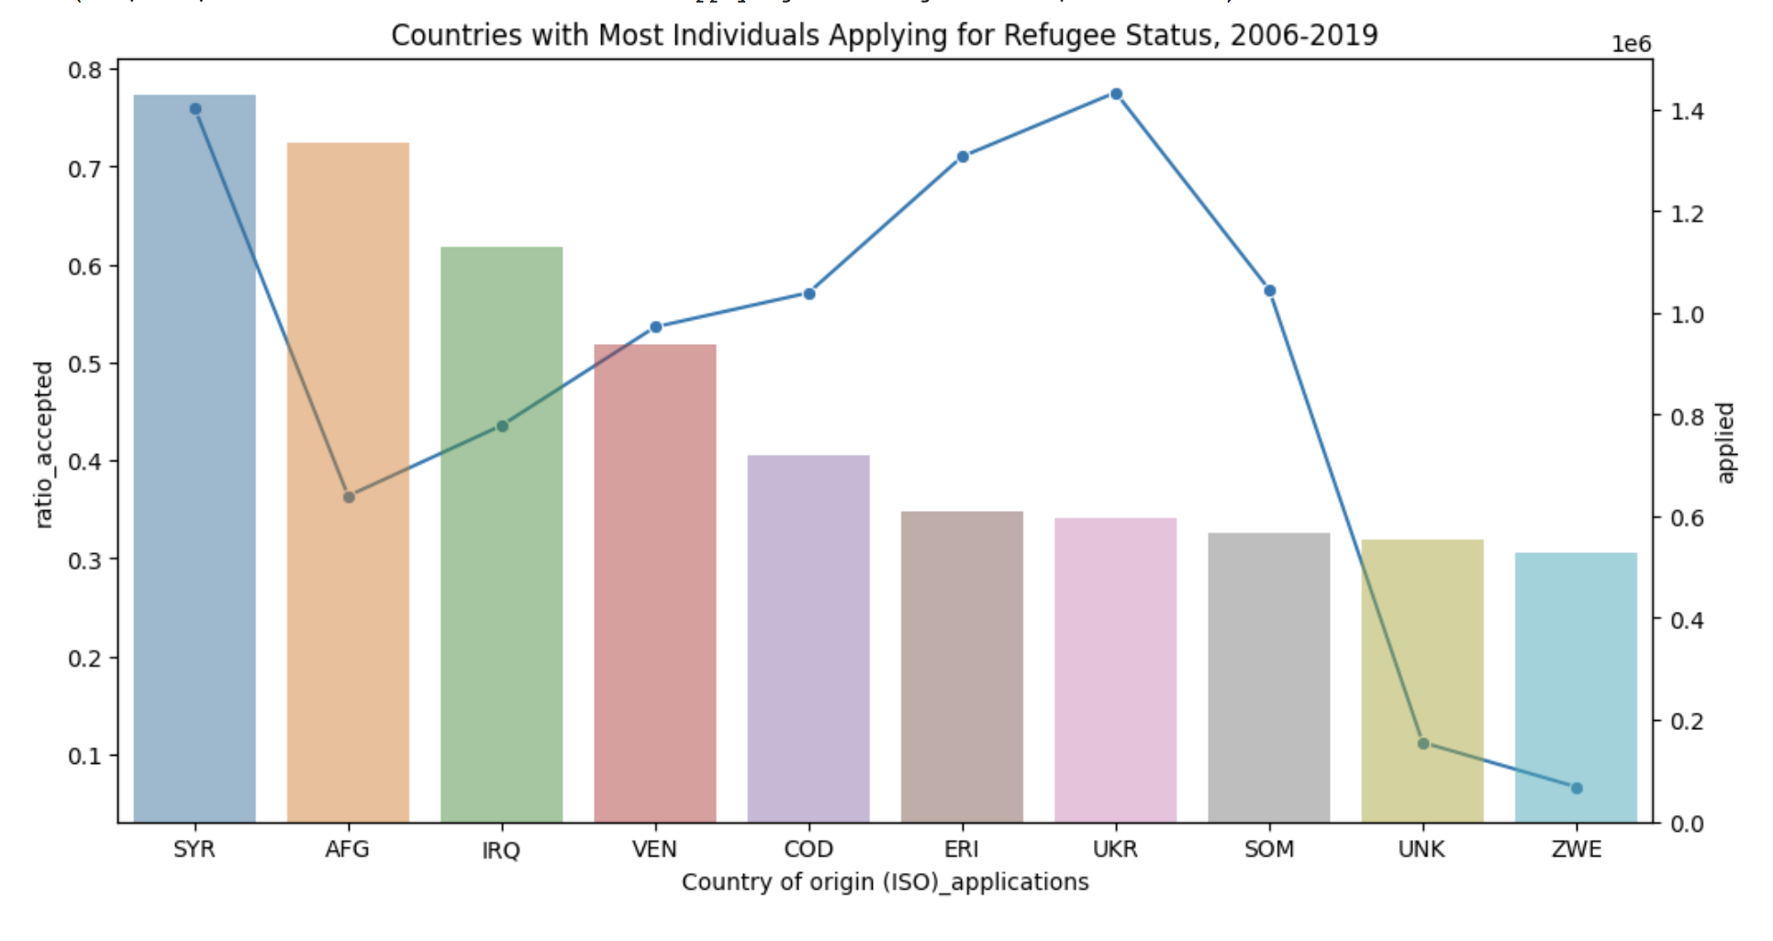
Data Cleaning & Exploration

Slide 9
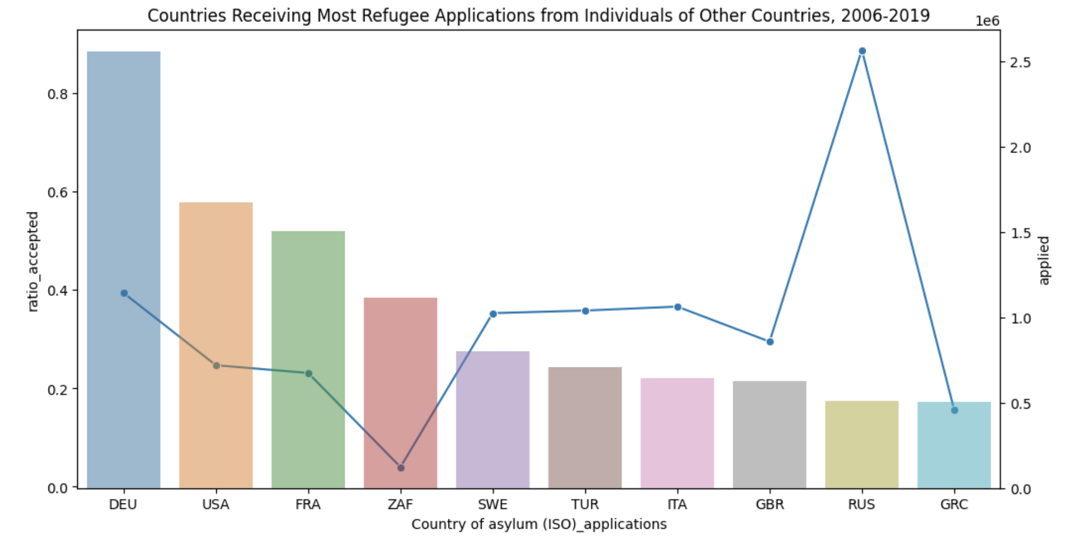
Data Cleaning & Exploration

Slide 10
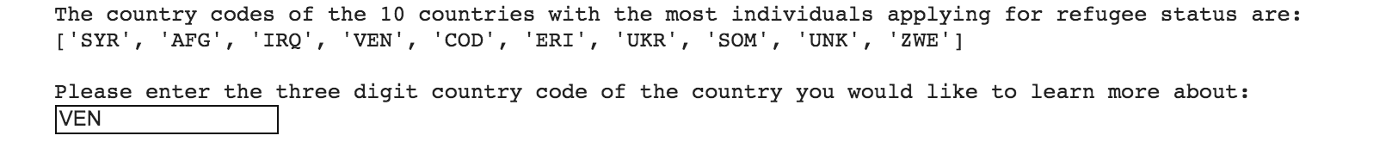
Case Study | Venezuela
Step 1: Enter ‘origin’
Step 2: Enter country code for Venezuela
Notes:
In order to demonstrate our program, we’ll walk through a case study using venezuela as the country of origin. In this example, you can see that our program prompts the user to type in whether they want to learn more about a country of origin or a country of asylum. In this case, we’ll type in origin. At the next user prompt, we will type in ‘VEN’ in order to dive deeper into the country of Venezuela.

Slide 11
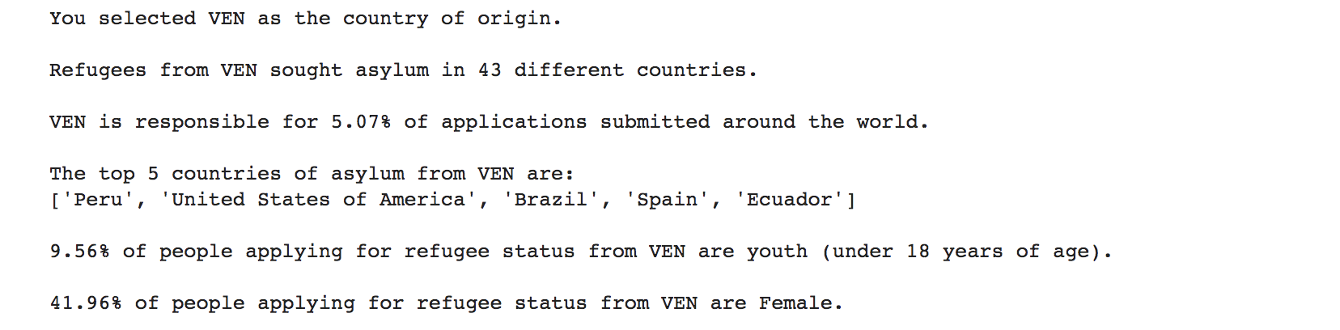
Case Study | Venezuela
Step 3: Review quick stats about Venezuela as a Country of Origin
Notes:
Next the user will be able to view a handful of statistics about individuals applying for refugee status from Venezuela. For example, refugees from Venezuela sought asylum in 43 different countries. The country is responsible for 5.07% of the world’s applications from 2006-2019, and 9.56% of applicants were under the age of 18.

Slide 12
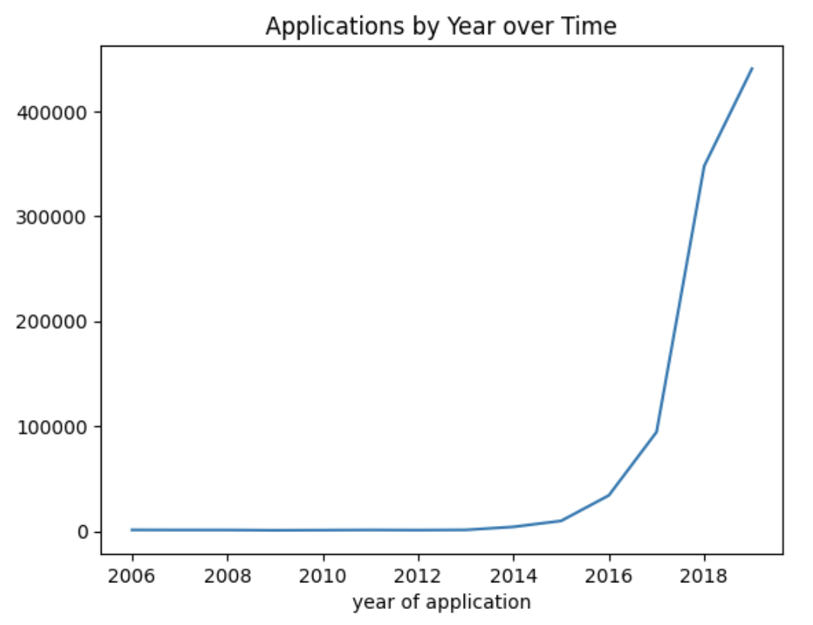
Case Study | Venezuela
Step 4: Review Visualizations
Notes:
Using Time Series, we can see a clear upward trend in refugee applicants from Venezuela. A policy maker in a country of asylum seeing a large spike in applications from Venezuela should look into what might be causing the spike and see if their country has the ability to help. As it turns out, major economic and political crisis hit Venezuela around 2013, and it appears people began exiting at an exponential rate beginning in 2016.

Slide 13
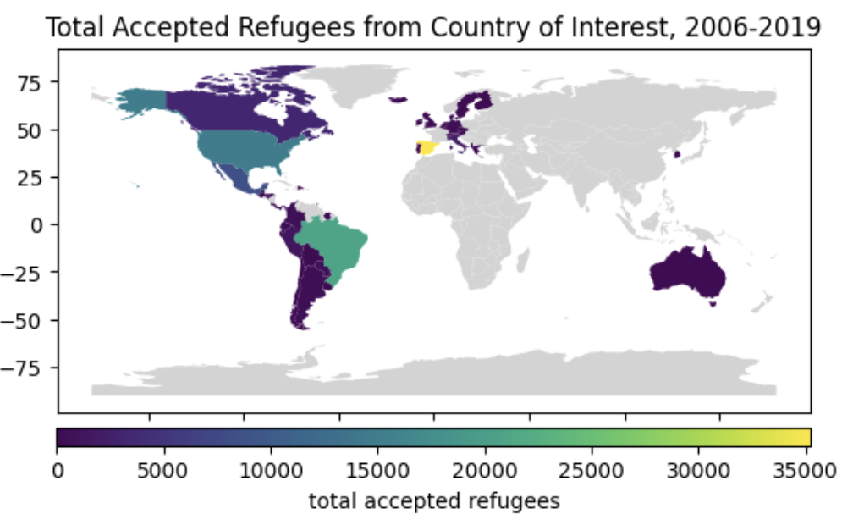
Case Study | Venezuela

Slide 14
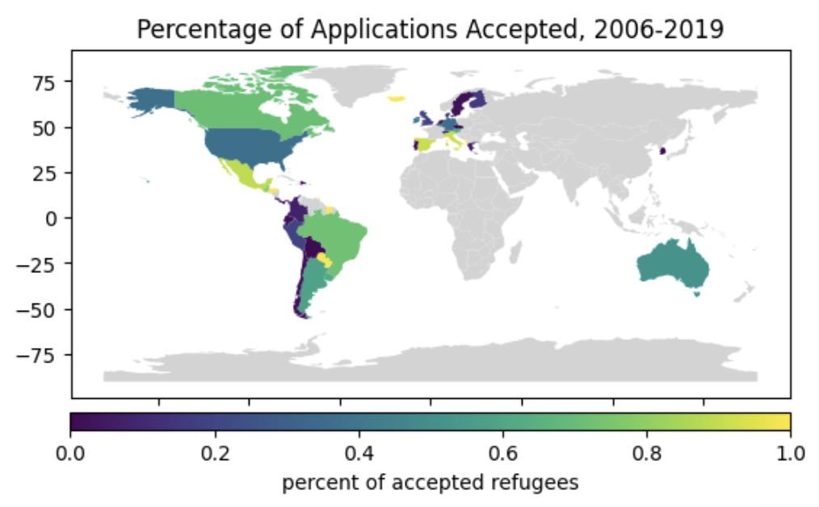
Case Study | Venezuela

Slide 15
Future Work
Convert to interactive web application
Look into resources available for refugees in each country of asylum
Layer in data directly referencing conflict/war around the world
Model predicting an upcoming rise in applications from particular countries

Slide 16
Questions?
Thank you!
Notes:
Hi everyone and welcome to our final presentation for CS5010. Allison, Amanda, and I will be presenting our findings on Refugee Resettlement from around the world between the years 2006 and 2019.

Slide 17
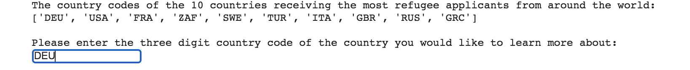
Case Study | Germany
Step 1: Enter ‘asylum’
Step 2: Enter country code for Germany

Slide 18
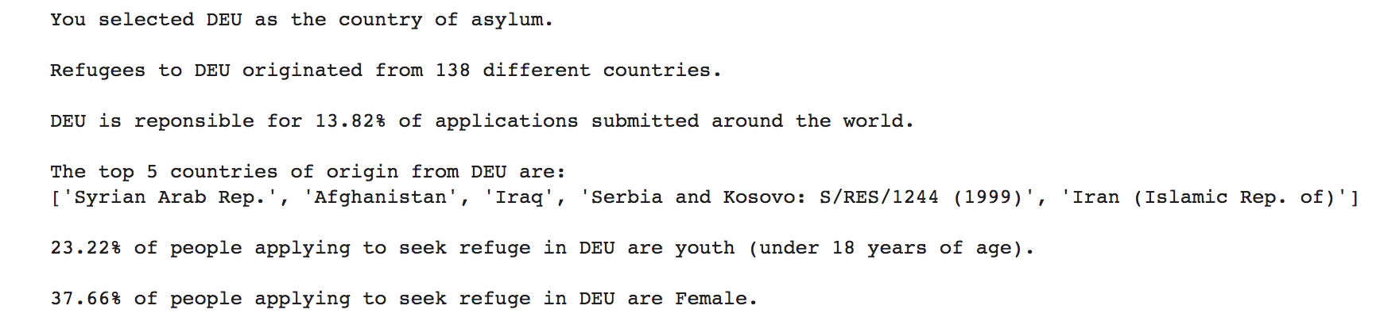
Case Study | Germany
Step 3: Review quick stats about Germany as a Country of Asylum

Slide 19
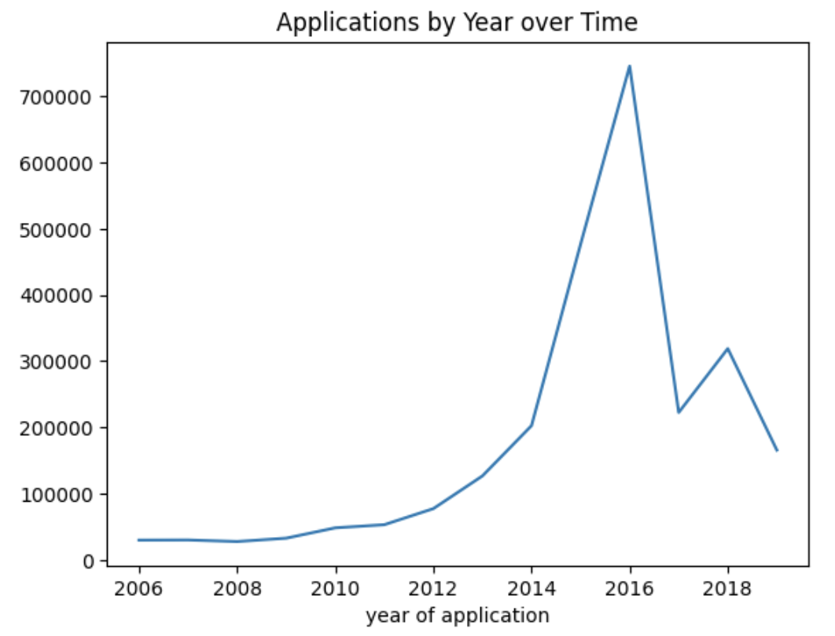
Case Study | Germany
Step 4: Review Visualizations

Slide 20
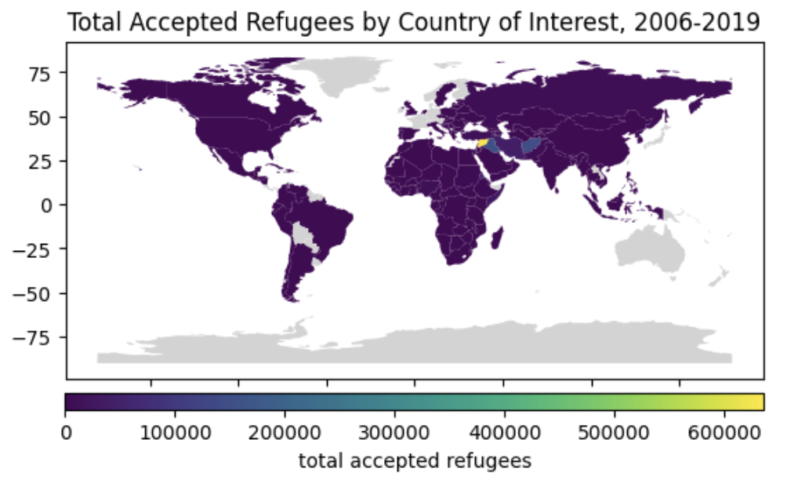
Case Study | Germany

Slide 21
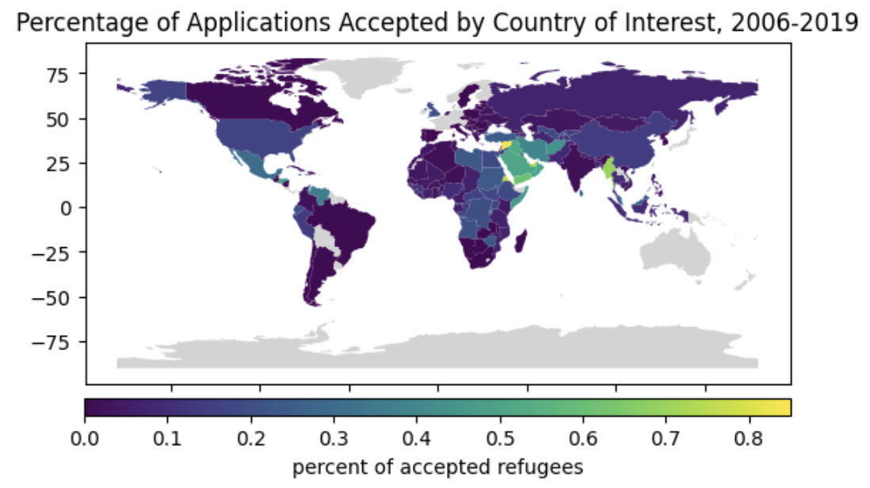
Case Study | Germany

